Slide 1
Sales and Profit Dashboard
File created on: 1/15/2021 10:28:47 AM

Slide 2


Slide 3
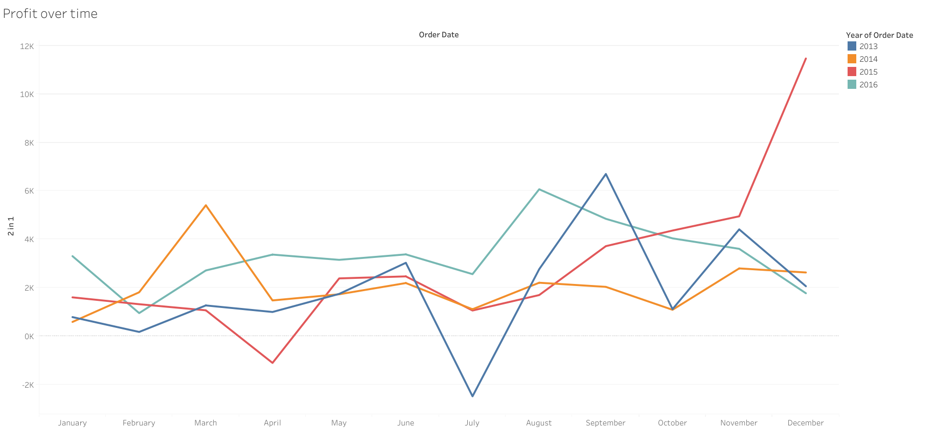

Slide 4
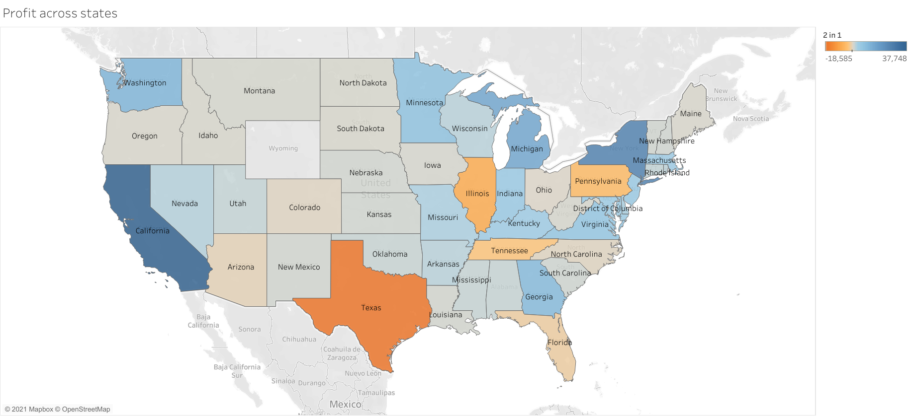

Slide 5
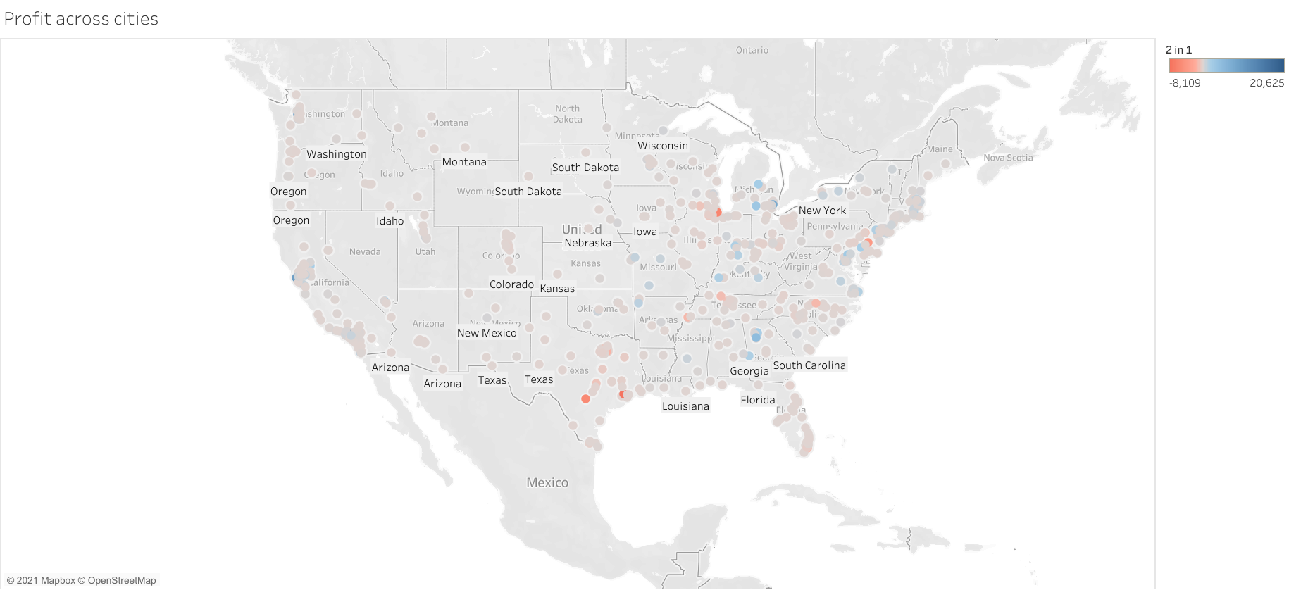

Slide 6
